Slide 1
Transportation of Hazardous Substances Unit - II

Slide 2
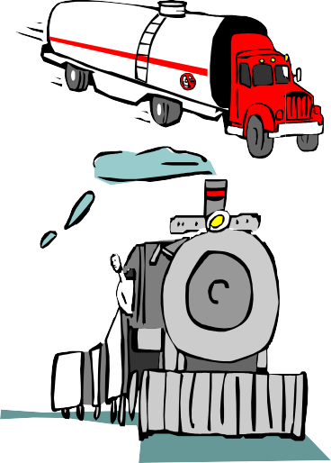

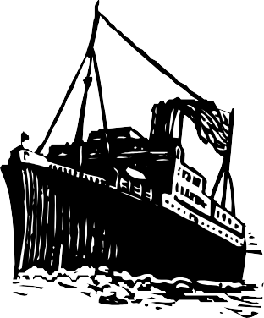

Transportation of dangerous Materials
● (Different modes of transport.)

Slide 3
CLASSIFICATION OF
DANGEROUS MATERIALS
As per classification of International Maritime Association & BIS
EXPLOSIVE
GASES
3. FLAMMABLE LIQUID
4. FLAMMABLE SOLID
5. OXIDISING SUBSTANCES
6. TOXIC & INFECTIOUS SUBSTANCES
7. RADIOACTIVE
8. CORROSIVE SUBS.
9. MISCELLANEOUS DANGEROUS SUBS
.
THE CLASSIFICATION IS BASED ON BIS 1446 (2000)

Slide 4
Hazard wise Classification
As recommended by National Academy of Science (USA)
Fire Hazard
Vapour Irritant Health Hazard
Liquid Solid Irritant Health Hazard.
Poison Health Hazard
Human Toxicity water Pollution Health hazard.
Aquatic Toxicity water Pollution Health hazard.
Aesthetic Effect water Pollution hazard.
Reactivity hazard with other Chemicals.
Water reactivity Hazard.
Self reactivity Hazard.

Slide 5
Road Transport Hazards
Causes of Accidents:
○ Road Accidents and over turning.
○ Driver fault like overfilling.
○ Poor maintenance of vehicle.
○ Poor inspection.
○ Lack of proper training of employees.

Slide 6
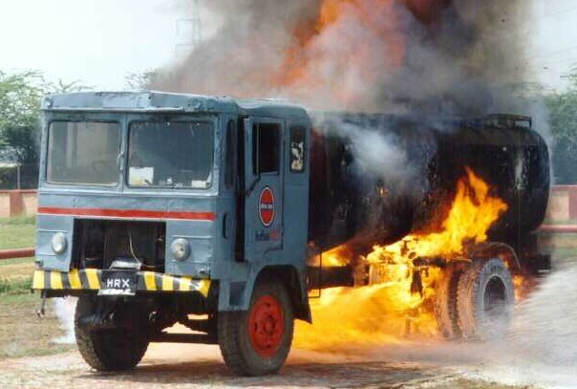
LPG Tank Truck Under Fire

Slide 7
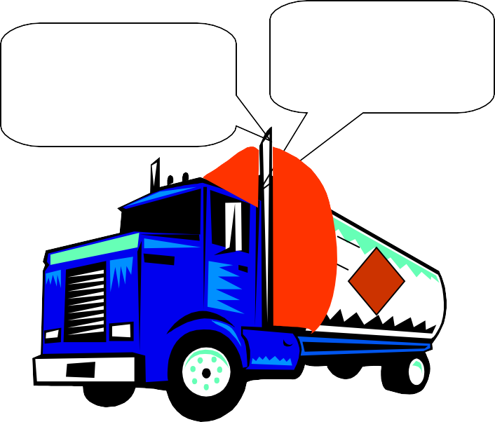
Special Requirements for Flammable Material Tank Truck
Fire proof Screen between load l& crew cab.
Exhaust in front of the screen.
Voltage of lighting current less than 24 volts.
Arrangement to cut off power quickly with double pole switch.
Double pole wiring and flame proof electrical fittings (For flammable substances).
Fire proof screen
Exhaust

Slide 8


Special Requirements for Flammable Material Tank Truck
Appropriate emergency kits, PPE and first aid box.
Fire extinguisher suitable for load fire.
Normal cab fire extinguisher compatible to load.
Labeling should include generic name, pictorial indication, and emergency information.
Emergency isolation Valve (Manual & Auto on Fire)
Propane
CAS xx

Slide 9
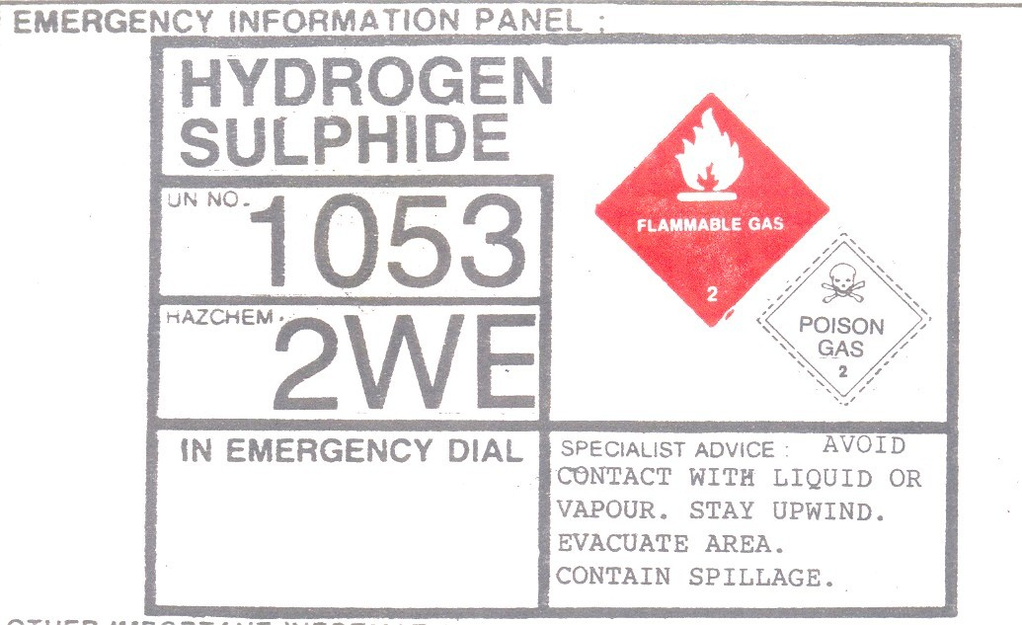
Evacuation of population is required
Water or foam or dry agent can be used but not water jet
Chemical is violent (v) or explosively reactive

Slide 10
EMERGENCY INFORMATION PANEL
THE SIZE OF THE EMERGENCY INFORMATION PANEL IS 800MMX600MM.
CORRECT TECHNICAL NAME OF THE DANGEROUS SUBSTANCE SHOULD BE IN ENGLISH. THE LETTER SIZE SHOULD NOT BE LESS THAN 50MM HIGH.
THE UN NUMBER OF THE DANGEROUS SUBSTANCE SHOULD NOT BE LESS THAN 100MM HIGH.
● HAZCHEM CODE (EAC) SHOULD BE IN LETTERS NOT LESS THAN 100MM HIGH.

Slide 11
EMERGENCY INFORMATION PANEL(Cont.)
● THE TELEPHONE NUMBER AND NAME OF THE EMERGENCY SERVICE TO BE CONACTED SHOULD BE IN LETTERS NOT LESS THAN 50MM HIGH.
●
THE SPECIALIST ADVICE SHOULD IN LETTER SIZE NOT LESS THAN 50MM HIGH AND MUST BE CLEAR AND PRECISE.
●
THE SIZE OF UN CLASS LABEL SHOULD NOT BE LESS THAN 250MMX 250MM IN CASE OF SUBSTANCES HAVING ONLY ONE TYPE OF RISK. IN HAVING A SUBSIDIARY RISK THE SIZE SHOULD NOT BE LESS THAN 200MMX200MM AND THE SUBSIDIARY RISK LABEL OF A SIZE NOT LESS THAN 150MMX150MM.

Slide 12
EMERGENCY ACTION CODE (HAZCHEM CODE)
EAC Signify:-
What fire – Extinguishing agent should be employed.
Whether the spillage should be contained or diluted with water.
Whether the substance is violently reactive.
What P.P.E. should be used.
Whether evacuation is required or not.

Slide 13
Emergency Action Code (HAZCHEM CODE)
FOR FIRE OR SPILLAGE OF HAZARDOUS SUBSTANCES
EMERGENCY ACTION CODE SCALE
FOR FIRE OR SPILLAGE 1: JETS
2: FOG
3: FOAM
4: DRY AGENT
NOTES FOR GUIDEANCE
FOG: In the absence of fog equipment a fine spray may be used.
DRY AGENT: Water must not be allowed to come into contact with
the substances at risk.
V: Can be violently or even explosively reactive.
FULL: Full body protective clothing
with BA.
BA: Breathing apparatus plus protective gloves.
DILUTE: May be washed to drain
with large quantities of water.
CONTAIN: Prevent, by any means
available, the spillage from entering drains or water course.
P | V | FULL DILUTE
R
S | V | BA
S |  | BA FOR FIRE
 |  | ONLY
T |  | BA
T |  | BA FOR FIRE ONLY
W | V | FULL | CONTAI
X |  |  | N
Y | V | BA
Y |  | BA FOR FIRE ONLY
Z |  | BA
Z |  | BA FOR FIRE ONLY
2 SE- methane
3 YE- propyl acetate
4 WE – hydrogen fluoride
E
CONSIDER EVACUATION

Slide 14
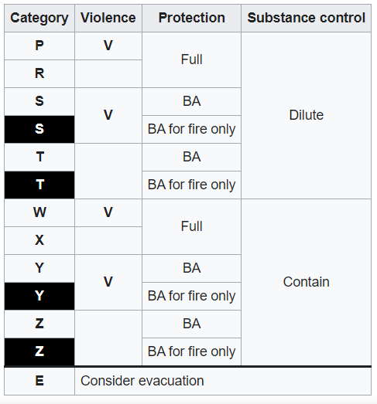
The HAZCHEM code for LPG gas is 2WE, in this ‘W’ relates to what?
Fire extinguisher type
Evacuation of the personnel
Personal Protective equipment
https://industrialsafetyguide.com/hazchem-code/

Slide 15
CHECKING OF TRUCKS AND TANK-LORRIES BEFORE FILLING
VALIDITY OF THE DRIVING LICENCE AND THE PETROLIEUM LICENCE IN FORM IX.
RELEVENT DOCUMENTS PERTAINING TO LOADING OR UNLOADING OF CHEMICALS.
TREAMCARD AND INSTRUCTIONS TO THE DRIVERS AND CLEANERS.
GENERAL CONDITION OF THE VEHICLE.

Slide 16
GENERAL CONDITION OF THE VEHICLE .
CONDITION OF TYRES AND STEPNEY.
CORRECTIONESS OF THE EMERGENCY INFORMATION PANEL AND THE UN HAZARD CLASS SYMBOLS.
CONDITION OF VALVES.
CONDITION OF THE DRIVER’S CAB
CONDITION OF THE SELF-STARTER AND INSTRUMENTS.

Slide 17
GENERAL CONDITION OF
THE VEHICLE .
(cont.)
CONDITION OF ELECTRICAL WIRING.
PROPER SEALING ARRANGEMENTS.
CONDITION OF WIPERS, HEAD LIGHTS, SIGNAL LIGHTS, BUMPERS, MUDGUARDS, ETC.
CONDITION OF METAL- WORK AND PAINT.
PROVISION OF FIRE EXTINGUISHERS AND THEIR CONDITION.

Slide 18
GENERAL CONDITION OF THE VEHICLE . (Cont.)
PROVISION OF TOOL BOX
FIRST- AID BOX.
PROVISION AND CONDITION OF THE SAFETY VALVES.
PROVISION OF A SAFETY TOURCH.
PROVISION OF REQUIRED P.P.E.
IN THE CASE OF EMPTY TANK-LORRY REPORTING FOR LOADING, CHECK WETHER
-CONT-

Slide 19
GENERAL CONDITION OF THE VEHICLE . (Cont.)
THE TANK IS CLEAN OR NOT.
THE PREVIOUS LOAD WAS THE SAME PRODUCT OR DIFFERENT.
THE TANK HAS BEEN THOROUGHLY CLEANEDBY WASHING, STEAMING AND THEN PURGING WITH NITROGEN IF PREVIOUS LOAD WAS A DIFFERENT PRODUCT.

Slide 20
CERTIFICATE OF FITNESS
TYRES(INCLUDING SPARE TYRE),TYRE PRESSURE, WHEEL NUTS, JACK, WHEELCHOCKS.
OIL AND OIL PRESSURE.
BRAKE PRESSURE.
BRAKE AIR RESERVE TANK.
FOOT-BRAKE AND HAND-BRAKE.
CLUCH TRAVEL
WINDSHIELD WIPER.
HORNS.

Slide 21
CERTIFICATE OF FITNESS (cont.)
ALLELECTRICAL SWITCHS.
REAR- VIEW MIRROR.
LIGHTS,BRAKELIGHTS.
CHASSIS SUSPENSION.
WATER LEVEL IN RADIATOR.
FRONT WHEEL ALIGNMENT.
STEERING.

Slide 22
CERTIFICATE OF FITNESS (cont.)
FIRE EXTINGUISHERS
EXHAUST FLAME- ARRESTOR.
FIRST- AID BOX.
EMERGENCY INFORMATION PANEL AND HAZARD CLASS LABELS.

Slide 23
EMERGENCY KIT
Explosimeter.
Earthing Cables.
Nuts And Bolts.
Gaskets.
Spanners and other Tools.
Safety Torch.
Nitrogen Cylinder.
Nitrogen Regulator and Hose.
Butyl Rubber Hose for Product Transfer.
Gumboots.
Safety Goggles.
Face – Shield.
Set of MSDS/Chemical information sheets and Tremcards

Slide 24
Special Requirements for Flammable Material Tank Truck
Air inlet to vehicle engine should be provided with flame arrester if loads are flammable gases or liquids.
Air Filter
Flame arrestor
Engine

Slide 25
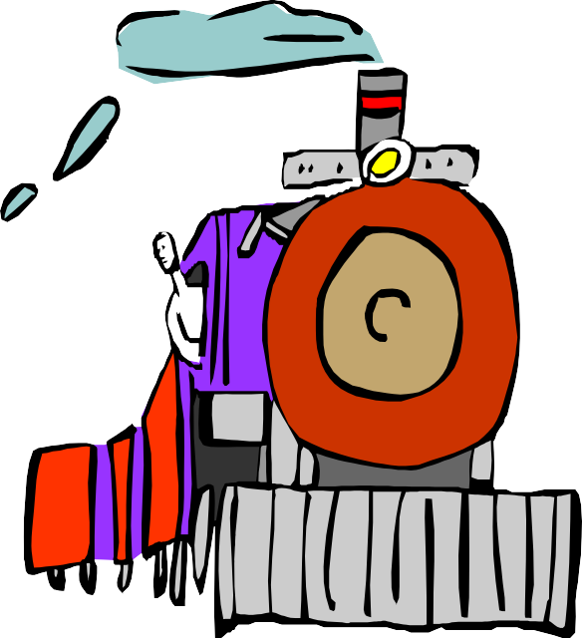
Rail Transportation of Dangerous Materials
Rail Transportation is safer because two persons can haul a large number of wagons.
Yet serious Fires and leakage may occur due to:
○ Derailment or collisions.
○ Lack of proper inspection and maintenance.
○ Use of unfit equipment and tank cars
○ Sources of ignition e.g. Engine, caboose, or brake shoe sparks are readily available.

Slide 26



Precautions in Rail Transport
Proper Labeling of Hazardous Cargo wagons
Place them at least 3 wagons away from engine or kitchen car.
Meticulous inspection of the whole train.
Display of instructions in the language known to the workers.
Do not overload.
Emergency team of specialised persons should be kept ready.

Slide 27
Precautions in Rail Transport
The trains of hazardous cargo should be routed through unpopulated areas.
Wagon coupling should be such that may not disengage on derailment.
Chances of penetration of coupling devices into the tanks should be avoided.
As for as possible safety valves should be preferred over rupture discs.

Slide 28
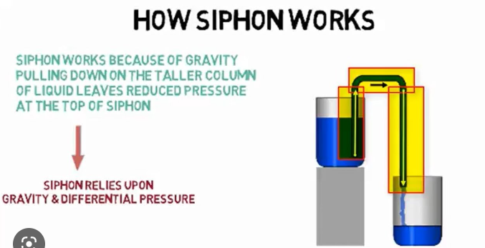
Precautions in Rail Transport
If chances of explosion exist, the explosion vents should be provided.
Siphoning of the liquid while transfer should be preferred over unloading from bottom.
The tanks should be lined suitably if corrosive substances are handled.

Slide 29
Transport Container Safety
(Common for rail, road and water transport)
Design should ensure enough strength to withstand normal and abnormal road shocks.
Material of construction should be resistant to the contents under all possible temperature and pressure conditions.
Minimum wall thickness T=0.125(Di/T)^{0.5} where Di is internal diameter in inches and T is tensile strength (Tons /in²)

Slide 30
Transport Container Safety
(Common for rail, road and water transport)
4. Test Pressure well above the maximum working pressure.
S V
5. Filling ratio should be decided on the basis of the thermal cubical expansion between the filling temperature and the reference
temperature.

Slide 31
Transport Container Safety
(Common for rail, road and water transport)
Safety valve or rupture disc for venting. (no rupture disc for toxic and flammable substances)
Proper arrangement for grounding and bonding of the vehicle while filling and discharging.
Other aspects as per the applicable statutes and standards.

Slide 32
Transport of Dangerous Materials by Pipelines
Petroleum crude, petroleum products, natural gas etc. are transported by this mode.
Pipelines are as wide as 40-50” dia, laid 4-5 feet under the ground, running at about 1200 psi.
Pumping of fluids is done from the dispatch end and boosters are provided at an average distances of about 100 miles in plane areas. In hilly areas the topography is taken into consideration.
The system conditions are monitored with the help of automatic monitoring and control devices and inspection of the installations is done by closed circuit TV.

Slide 33
Transport of Dangerous Materials by Pipelines
Any leakage in the line is indicated by pressure drop in the system.
It is possible to find out the extent of leakage and distance of the leak point from the control point is possible.
Problems often arise due to external interventions like excavations, meddling and farming activities.
Line inspection is done manually with the help of line walkers and by aerial survey by helicopters and aircrafts.

Slide 34
Wa Transport of da erous
●
Transport of dangerous materials by water is
Mat
als
common all over the world for international transport. In some countries internal transport by barges and ships is also common

Slide 35
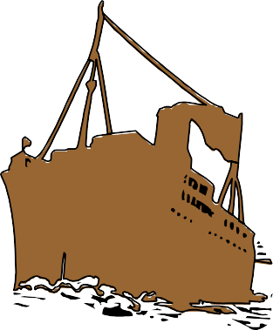

Water Transport of dangerous Materials
Comprehensive standards and international regulations for hull design and venting and level gauging etc. and for classification of dangerous materials exist and are in use all over the world.
Operating personnel are adequately trained and certified.
Strict navigational safety.
Proper emergency response procedures.

Slide 36
Wa Transport in Ba s
Double skin with cylindrical tanks
Single skin barge
Double skin barge
Hull

Slide 37
Salient Features of Central Motor Vehicle Rules
Consigner,s Responsibilities
Tremcard with way bill.
Hazard Information to the transporter in advance.
Ensure driver has been trained adequately.
Ensure that the driver has undergone statutory training on transport of dangerous materials and his license has been duly endorsed by the respective RTO.
Ensure that the vehicle meets the requirements and Emergency information panels have been displayed at both the sides and on the rear.
○
• Consigner,s Responsibilities
– Tremcard with way bill.
– Hazard Information to the transporter in advance.
– Ensure driver has been trained adequately.
– Ensure that the driver has undergone statutory training on transport of dangerous materials and his license has been duly endorsed by the respective RTO.
– Ensure that the vehicle meets the requirements and Emergency information panels have been displayed at both the sides and on the rear.
○

Slide 38
Salient Features of Central Motor Vehicle Rules
Consignee’s responsibilities
– Before allowing into the premises, ensure that all the requirements of the rules have been met with.
Driver’s Responsibilities
– Ensure that he is aware of all the hazards, precautionary measures and emergency response procedures.
– He will report to the nearest police station and warn public. He will also inform consigner, transporter and consignee.
•• Consignee’s responsibilities
Before allowing into the premises, ensure that all the requirements of the rules have been met with.
•• Driver’s Responsibilities
Ensure that he is aware of all the hazards, precautionary measures and emergency response procedures.
He will report to the nearest police station and warn public. He will also inform consigner, transporter and consignee.

Slide 39
Salient Features of Central Motor Vehicle Rules
Transporter’s Responsibilities
Ensure that the vehicle is fit condition and driver has been trained properly about the information received from the consignee.
Ensure that the Emergency information panels have been duly painted or posted on the vehicle.
Ensure that the driver’s license has been endorsed by RTO.

